Slide 1
Azure

Slide 2
Introductions
Toi B Wright (toi@onestopdesigns.com)
President and Founder,
Dallas ASP.NET User Group
Microsoft MVP ASP.NET since 2005
President, Geeks in Pink
Author, 24-Hour Trainer ASP.NET 4
BS in CS from MIT
MBA from CMU

Slide 3
Welcome
The purpose of this user group is to help developers learn ASP.NET.
Our intent is to provide a forum for you to learn about and discuss the various components of a production quality ASP.NET application.
www.dallasasp.net

Slide 4
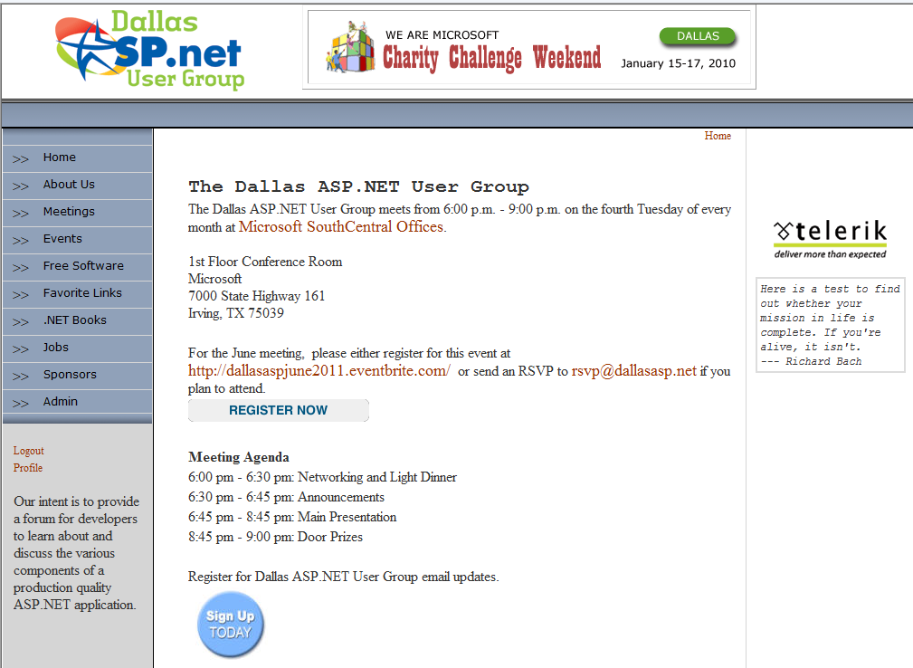
Our Website

Slide 5
Agenda
User Group Business
Announcements
Main Presentation
Door Prizes

Slide 6
User Group Business

Slide 7
Paperwork
Door Prizes
Dues
Renewal / Joiner Gift
RSVP by Noon
LinkedIn
Venue Layout
Notes:
LinkedIn

Slide 8

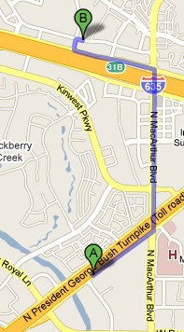
Later Tonight
Chili’s Grill & Bar
1300 Market Place Blvd Irving, TX 75063-7229 214-574-4574
Turn RIGHT onto access road 0.96 mo
Turn LEFT onto N MACARTHUR BLVD. 0.86 mi
Turn LEFT onto access road I-635 W/W LBJ FWY. 0.62 mi
Restaurant is on RIGHT
Notes:
8

Slide 9

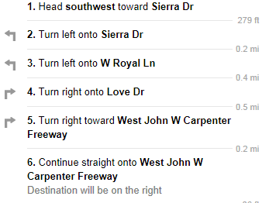
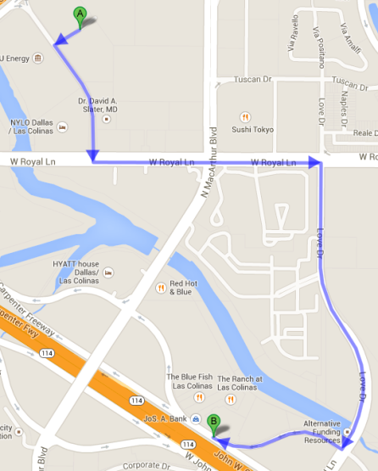
Later Tonight
Champs Americana
855 West John W. Carpenter FRWY Irving, TX 75039 972-373-0333
Notes:
9

Slide 10
Announcements

Slide 11
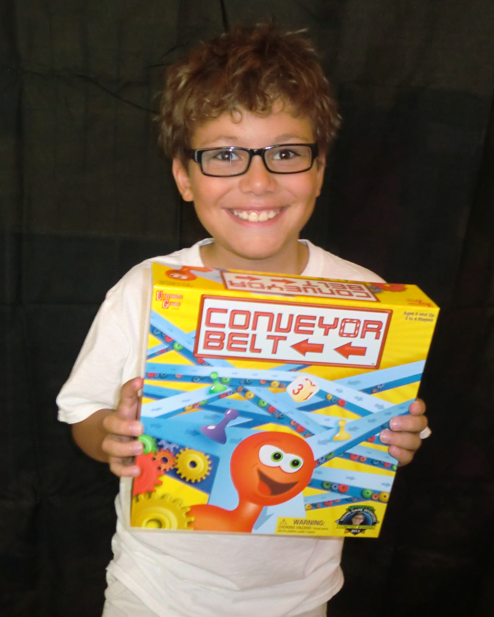
Conveyor Belt
Last year Franklin won the 2013 National Young Game Inventors Contest that was sponsored by University Games.
His game is currently available on Amazon and at Toys R Us.
www.franklinsfunfactory.com

Slide 12
TEALS
Technology Education And Literacy in Schools
TEALS is a grassroots program that recruits, trains, mentors, and places high tech professionals from across the country who are passionate about computer science education into high school classes as volunteer teachers
Application deadline is May 1st, 2015 to be considered for the 2015/16 school year.
http://www.tealsk12.org/
Notes:
TEALS supports two course levels of introductory high school computer science:
Introduction to Computer Science
AP Computer Science A
Stipends distributed evenly
Based on volunteer feedback, starting with the 2014-2015 school year, the volunteer stipend ($5,000 per course per year) will be split evenly between the volunteer team instead of basing the amount on the TA vs. Teacher role.

Slide 13
Visual Studio RC 2015
Contains many new and exciting features to support cross-platform mobile development, web & cloud development, IDE productivity enhancements, and more.
Visual Studio Community 2015 RC
Visual Studio Professional 2015 RC
Visual Studio Enterprise 2015 RC
http://www.visualstudio.com/en-us/downloads/
visual-studio-2015-downloads-vs
Notes:
Visual C++ for Cross-Platform Mobile Development
Visual Studio Tools for Apache Cordova
Visual Studio Emulator for Android
http://www.visualstudio.com/en-us/news/vs2015-preview-vs
https://www.visualstudio.com/products/visual-studio-community-vs

Slide 14
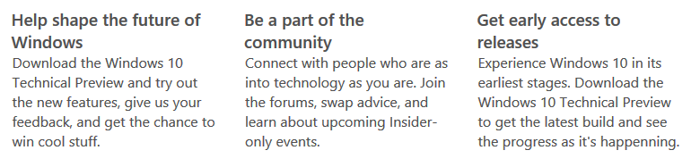
Windows 10 Technical Preview
What Do Insiders Do?
Free Upgrade Offer
https://insider.windows.com
Notes:
Free Upgrade Offer
Great news! We will offer a free upgrade to Windows 10 for qualified new or existing Windows 7, Windows 8.1 and Windows Phone 8.1 devices that upgrade in the first year!* And even better: once a qualified Windows device is upgraded to Windows 10, we will continue to keep it up to date for the supported lifetime of the device, keeping it more secure, and introducing new features and functionality over time – for no additional charge. Sign up with your email today, and we will send you more information about Windows 10 and the upgrade offer in the coming months.

Slide 15
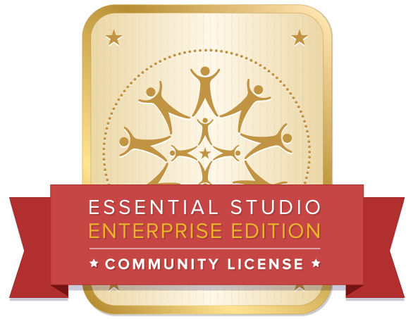
Syncfusion Software
The complete $9,975 Essential Studio is now FREE for individual developers and small businesses. (no credit card required)
1032621066
Offer includes over 650 components across 12 platforms, an easy-to-use big data platform, and much more. Support and updates are also included.
http://www.syncfusion.com/products/communitylicense

Slide 16
DevCamp: Cloud
Thursday, April 16
Microsoft, 9AM – 5PM
FREE
Master the new Microsoft Azure features and services to build, deploy and move apps to the cloud Roll up your sleeves and get ready to master the latest Microsoft Azure development tools and technologies.
https://msevents.microsoft.com/CUI/EventDetail.aspx
?EventID=1032613014

Slide 17
Make Your Customer Connections Count
Wednesday, May 27
Microsoft, 11AM – 1PM
FREE
You are invited to experience real life sales and marketing scenarios to maximize every customer interaction. This experience begins with a 90-minute envisioning demo at our state-of- the-art facility followed by a focused discussion.
https://msevents.microsoft.com/CUI/EventDetail.aspx
?EventID=1032621806

Slide 18
Dallas Startup Weekend: Women's Edition
Friday, May 29 - Sunday, May 31
The Dallas Entrepreneur Center
$75 (Discount Code: DSWWE15 for 25%)
Startup Weekend is a global grassroots movement of active and empowered entrepreneurs who are learning the basics of founding startups and launching successful ventures.
http://www.up.co/communities/usa/dallas/startup-weekend/5911
Notes:
The Dallas Entrepreneur Center 311 North Market Street, Suite 200 Dallas, TX 75202

Slide 19
DevCamp: Office
Thursday, June 4
Microsoft, 9AM – 5PM
FREE
Learn how to build apps using standard web technologies that extend the familiar Office and Office 365 experience and potentially sell them to over 1 billion Office users in 147 international markets.
https://msevents.microsoft.com/CUI/EventDetail.aspx
?EventID=1032621066

Slide 20
DevCamp: Data
Friday, June 12
Microsoft, 9AM – 5PM
FREE
The Cloud Data Camp will show how to use data services and platforms in Azure. Using a canonical IoT scenario for data analysis, lab participants will load, process and analyze data in Azure.
https://msevents.microsoft.com/CUI/EventDetail.aspx
?EventID=1032620394

Slide 21
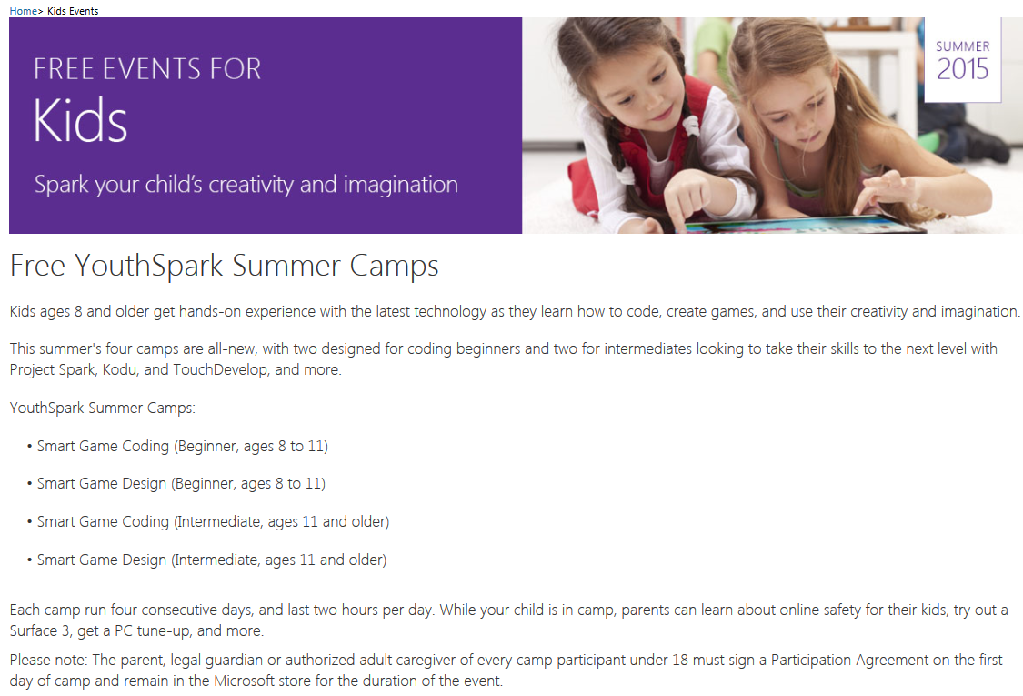
YouthSpark Summer Camps
http://www.microsoft.com/en-us/store/locations/kids-events

Slide 22
Microsoft Virtual Academy
Free Microsoft Training Delivered by Experts
MVA offers hundreds of courses, in 11 different languages. Our mission is to help developers, knowledgeable IT professionals and advanced students learn the latest technology, build their skills, and advance their careers. MVA is free of charge, and the entire service is hosted on Windows Azure.
http://www.microsoftvirtualacademy.com

Slide 23

FREE Online Training
Infragistics is offering FREE online training for groups of 10 or more ($4,000 value)
Framework
Silverlight Boot Camp by Infragistics
WPF Boot Camp by Infragistics
Infragistics products
Developing Applications with NetAdvantage® WPF Controls
Developing Applications with NetAdvantage® Silverlight Controls
Contact Aaron Swan for details (aswan@infragistics.com)
www.infragistics.com/services/ui/

Slide 24

WebsiteSpark
The WebsiteSpark program is no longer accepting new membership applications.

Slide 25
Microsoft BizSpark
BizSpark is designed to give startups access to the tools, support and visibility they need, when they need it the most.
Support
Software
Visibility
http://www.microsoft.com/BizSpark
Notes:
Software. Receive fast and easy access to current full-featured Microsoft development tools, platform technologies, and production licenses.
Support. Each of your developers will get access to a MSDN Premium subscription. You'll also get connected a global community of technical and business development experts.
Visibility. Achieve global visibility to an audience of potential investors, clients and partners.
There are no upfront fees for BizSpark access, enrollment or registration services, just a $100 Program Fee upon program exit.

Slide 26
Microsoft BizSpark Requirements
Your Business →
Is developing software or apps
Is privately held
Has been in business for less than 5 years
Making less than US $1 million annually
Is sponsored by a BizSpark Network Partner
http://www.microsoft.com/BizSpark
Notes:
To enroll, you must be sponsored by a BizSpark Network Partner. Find a BizSpark Network Partner.
To be eligible to use the software for production and deployment of hosted solutions Startups must also be developing a new “software as a service” solution (on any platform) to be delivered over the Internet.

Slide 27
Not Eligible for BizSpark
If you are developing dashboards, HTML editors, utilities, website, and similar technologies that are not considered primary service or application.
If you are a consultant
http://www.microsoft.com/BizSpark
Notes:
To enroll, you must be sponsored by a BizSpark Network Partner. Find a BizSpark Network Partner.
To be eligible to use the software for production and deployment of hosted solutions Startups must also be developing a new “software as a service” solution (on any platform) to be delivered over the Internet.

Slide 28
Azure

Slide 29
Shawn Weisfeld
Shawn (http://www.shawnweisfeld.com, shawn@shawnweisfeld.com) is passionate about building awesome applications and websites with .NET technologies and Azure.
He is currently a Technical Evangelist for Microsoft based in Austin TX and founder of http://UserGroup.tv.
Read his full bio at http://about.me/shawnweisfeld
The most awesome person ever!

